Slide 1
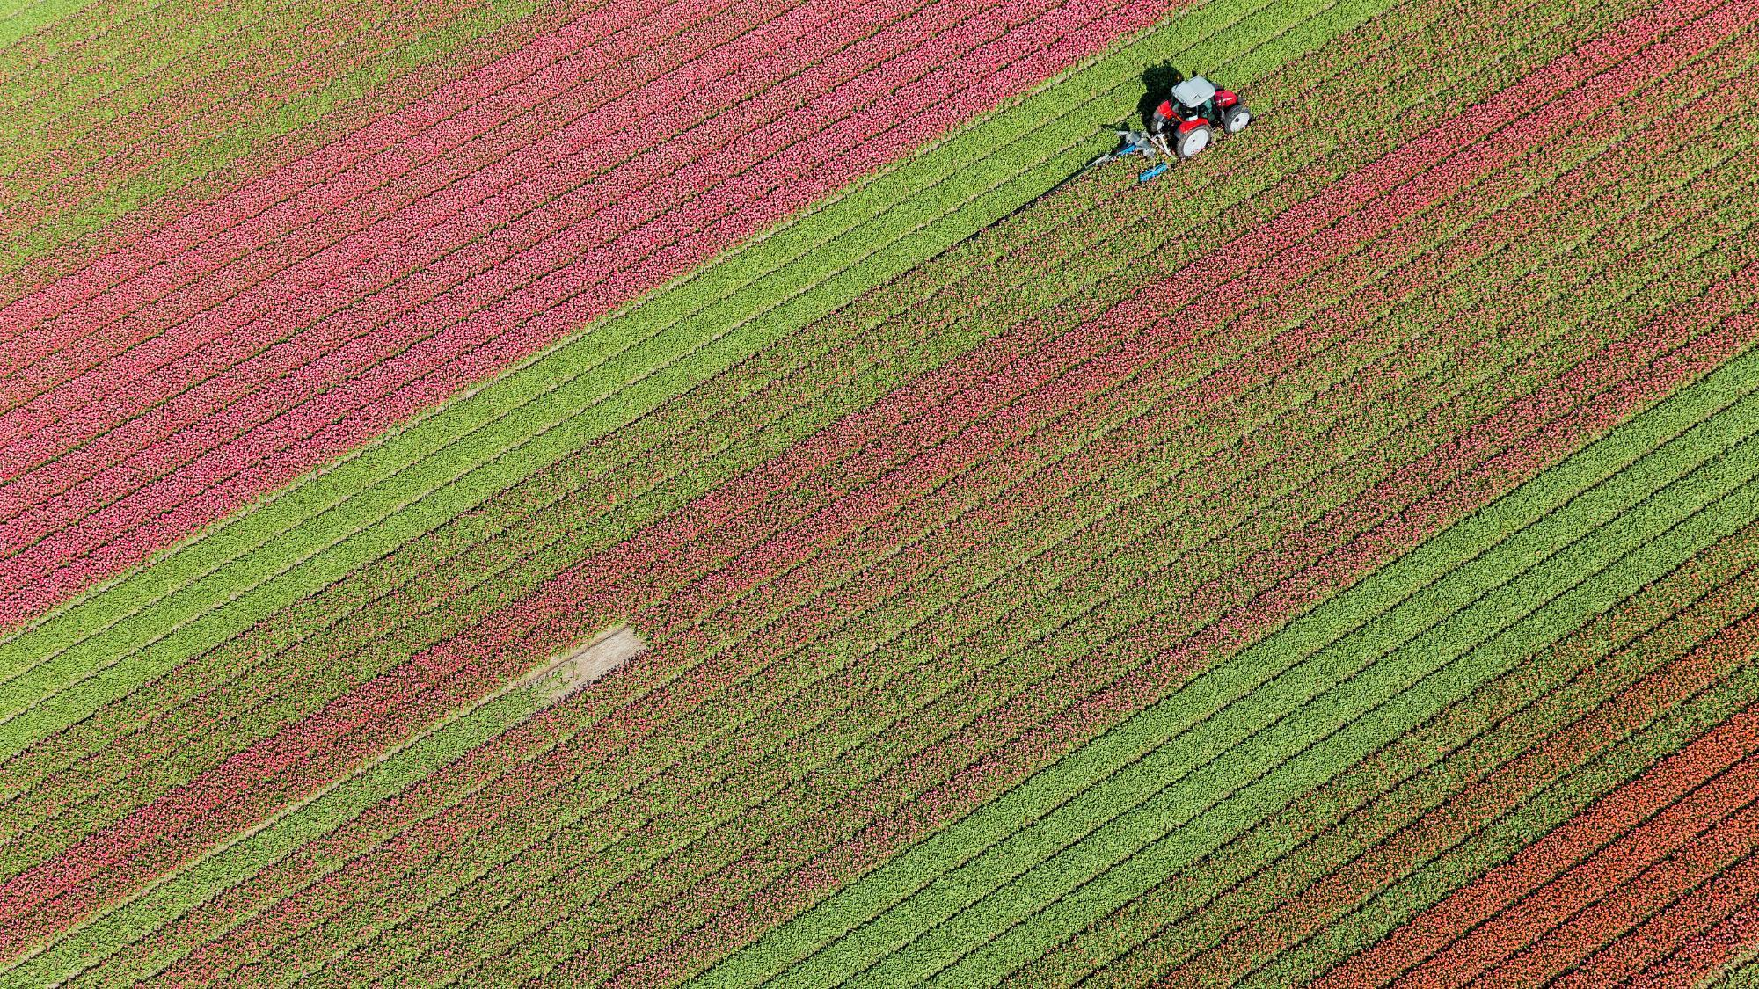
Farmcommendation: A Smart Crop Recommendation System using Machine Learning
134159 Julie Anne Enola
ICS 4A
Mr. James Gikera

Slide 2


Agenda
Background
Motivation
Designed Solution
Solution Demonstration

Slide 3
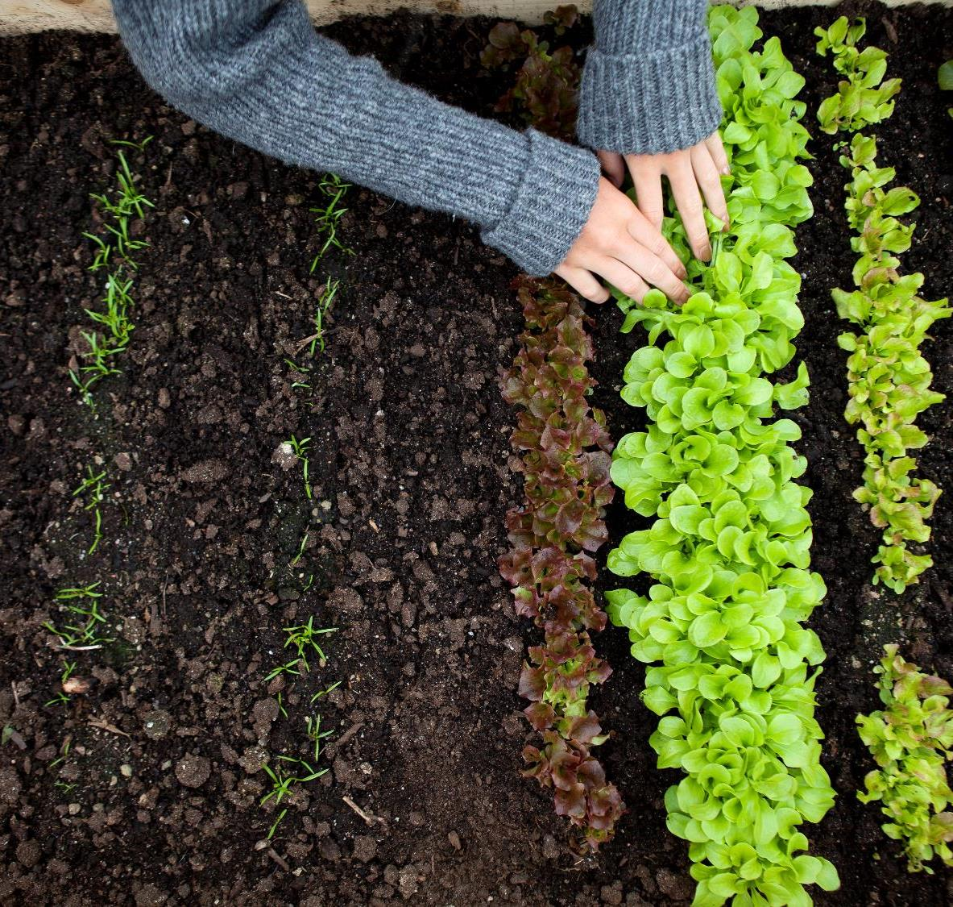
Background

Slide 4

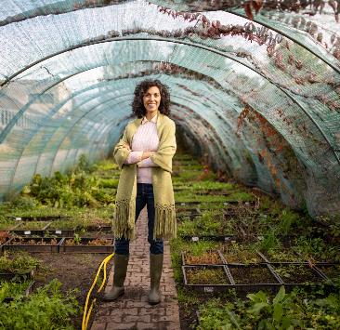
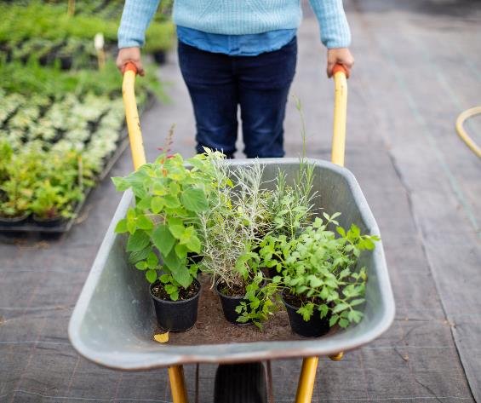
Background
Role of Agriculture in Kenya’s Economy
Issues that hinder agricultural activities: Climate change and soil degradation.
Problem Statement
Soil degradation, and climate variability are among the urgent issues facing Kenyan agriculture that are affecting farmers and lowering overall production. To address these issues, a Smart Crop Recommendation System leveraging machine learning and agricultural data is proposed. This system aims to empower farmers with recommendations based on temperature, humidity, pH, soil nitrogen, soil phosphorous and, soil potassium, ultimately contributing to sustainable agricultural development.

Slide 5
Motivation

Slide 6
Motivation
More informed crop choices.
Optimization of resource utilization.
Environmental Sustainability.
Zero Hunger.

Slide 7
Designed Solution

Slide 8
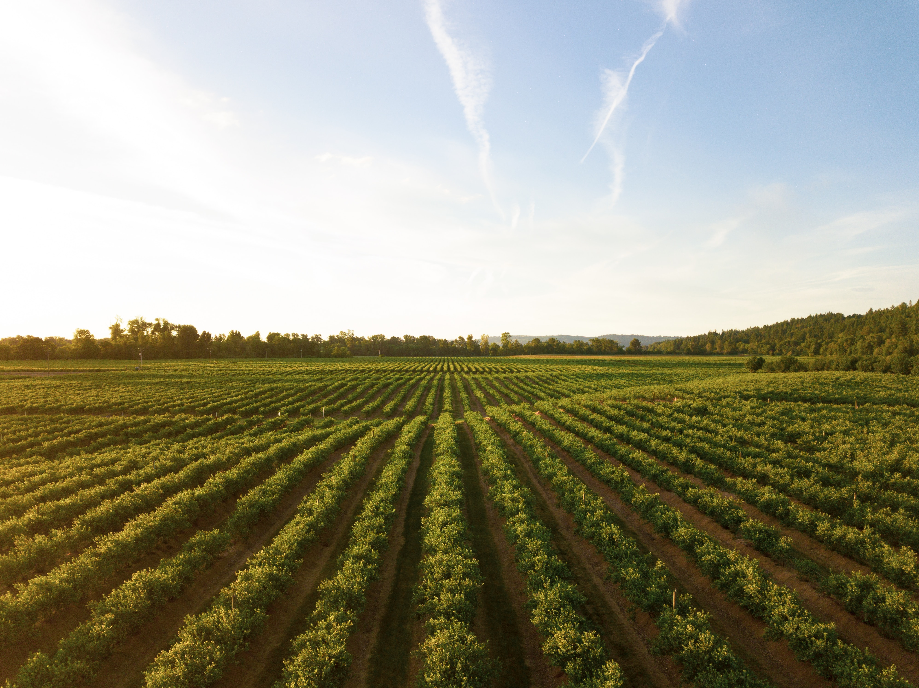
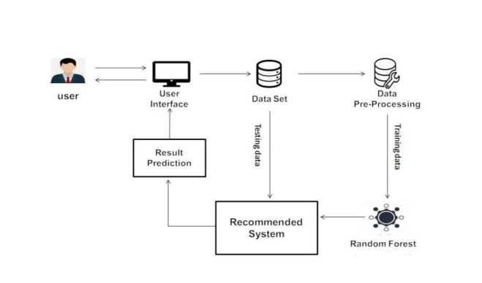
System Architecture
Diagram
EXPLANATION
User Interface
Dataset
Data Pre-processing
Random Forest
Recommendation System
Result Prediction

Slide 9
Dataset
Source: Kaggle
Entries: 2200
Crops: 22
Rice, maize, jute, cotton, coconut, papaya, orange, apple, muskmelon, watermelon, grapes, mango, banana, pomegranate, lentil, black gram, mung bean, moth beans, pigeon peas, kidney beans, chickpea, coffee
Features: 7
Soil Nitrogen, Soil Phosphorous, Soil Potassium, Temperature, pH, Humidity, Rainfall

Slide 10
Solution Demonstration

Slide 11
Dataset
We’ll be looking at how the dataset was used to create the prediction model.
Preprocessing
Model Training
Evaluation

Slide 12
System Demonstration

Slide 13

Any Feedback or Questions

Slide 14

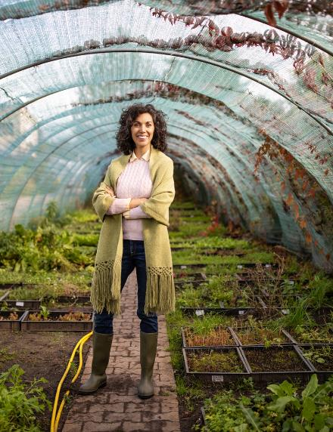
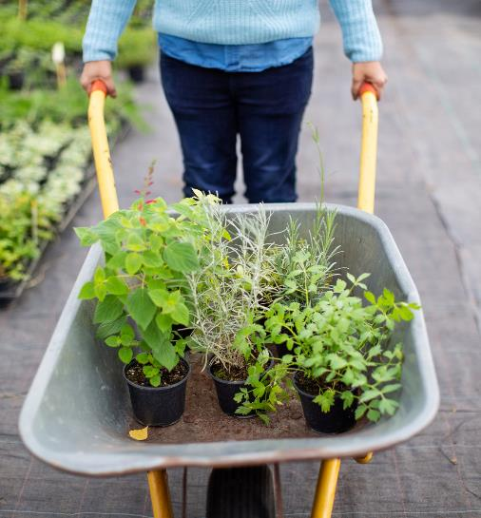

Thank You
Julie Anne Enola
134159
ICS 4A

